Slide 1

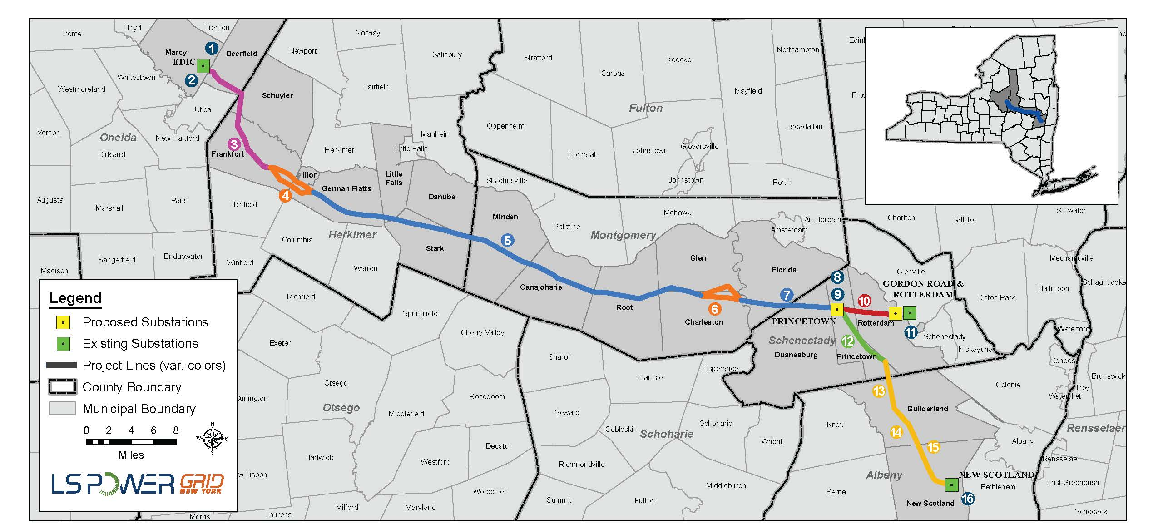
LS Power Grid New York Corporation I
2022 Annual Projection Stakeholder Meeting
November 10, 2021

Slide 2
Outline
Introductions
Background
Projection for 2022 Rate Year
Cost Containment Mechanisms
Discussion

Slide 3
Background
Company, Project, and Formula Overview

Slide 4
Background – General
Overview of the Company and the Project
LS Power Grid New York Corporation I (“LSPG New York”) is a transmission-only company initially formed to develop, own, and operate transmission projects in New York.
LSPG New York, jointly with the New York Power Authority (“NYPA”), was selected through NYISO’s Order No. 1000 competitive process to develop new 345kV transmission facilities between the existing Marcy/Edic substations near Utica, New York and the existing New Scotland and Rotterdam substations near Albany, New York
This Project is subject to certain cost cap, ROE, and equity capital structure commitments defined in the protocols as part of LSPG New York’s Public Policy Transmission Project proposal and the settlement agreement in ER20-716.
More information is available at lspgridnewyork.com

Slide 5
Background – Regulatory
Selected Regulatory Filings and Orders
December 31, 2019 – LSPG New York submits in Docket No. ER20-716 transmission formula rate to be incorporated into NYISO tariff and requests certain incentive treatment.
May 26, 2020 – FERC approves certain transmission rate incentives requested by LSPG New York in its December 31, 2019 petition while setting hearing and settlement procedures for other matters.
April 1, 2021 – Settlement agreement submitted to Commission.
June 17, 2021 – Commission accepts settlement agreement.

Slide 6
Formula Rate Timeline
General Update Process
Sept. 30, 2021
Sept. 30, 2022
Sept. 30, 2023
RY 2022 projected net revenue requirement published
RY2023 projected net revenue requirement published
RY 2024 projected net revenue requirement published
2021
June 30, 2022
June 30, 2023
RY2021 True-Up published
RY2022 True-Up published
2022
2023
2024
May 28, 2021
June 30+10, 2022
June 30+10, 2023
Initial facilities energized
Informational filing submitted to FERC
Informational filing submitted to FERC

Slide 7
Formula Rate Timeline
Selected milestones
September 29, 2020 – Publication of 2021 Projection
May 28, 2021 – Initial facilities energized
June 17, 2021 – FERC accepts settlement agreement
September 30, 2021 – Publication of 2022 Projection
October 31, 2021 – Last day to incorporate corrections into 2022 Projection
November 10, 2021 – Stakeholder meeting for 2022 Projection
January 1, 2022 – Scheduled end of information request period
April 2022 – Control centers, Gordon Road substation, and other facilities expected to go into service
June 30, 2022 – Publication of 2021 True-up and Annual Information filing within 10 days thereafter

Slide 8
Annual Projected Net Revenue Requirement Cost Containment and Risk Sharing Mechanisms
2022 Rate Year

Slide 9
Projected Revenue Requirement Summary
2022 Annual Revenue Requirement Projection
Appendix A Line Item | 2022 Projection
Average Rate Base | $ 125,826,376
Rate of Return¹ | 6.01%
Return on Rate Base | 7,559,122
Incentive Return | 830,170
Income Taxes | 2,318,073
Total Return & Taxes | 10,707,365
Operating Expenses: O&M and A&G Expenses Depreciation Expenses Non-income taxes | 7,758,511 3,635,785 1,317,260
Total Operating Expenses | 12,711,555
Gross Revenue Requirement | 23,418,921
Less: Revenue Credits | 0
Plus: True-up Adjustment with Interest | 0
Net Revenue Requirement | 23,418,921
¹ Refer to Weighted Average Cost of Capital (WACC) calculation for projection provided in separate slide.

Slide 10
WACC
Weighted Average Cost of Capital Calculation for 2022 Projection
WACC Element | Weight | Cost | Weighted
Long Term Debt | 47% | 1.90% | 0.89%
Preferred Stock | - | - | -
Common Stock | 53% | 9.65% | 5.11%
Total |  |  | 6.01% | = Return
Refer to Attachment 3 (Cost Support worksheet) in the published 2022 Annual Projection for more detail.

Slide 11
Cost Containment/Risk Sharing Mechanisms
LSPG New York is bound by certain cost containment and risk sharing mechanisms for the Project defined in the project proposal and settlement agreement
Cost Cap¹ – Twenty percent of Project costs greater than the binding cost cap of $316.5 million plus AFUDC do not receive any ROE.
Adjusted Cost Cap¹ – Project costs below $261 million plus AFUDC earn tiered ROE incentives.
¹ As defined in and subject to the settlement agreement in ER20-716.

Slide 12
Cost Containment /Risk Sharing Mechanisms
Reporting Overview (Protocols Section 7)
During construction period
Each June 30 – Cost updates with annual informational filing including
Unforeseeable costs
Third-party costs
Following entire Segment A project placed in service
Within six months – informational work paper providing
Final assets owned by LSPG New York and NYPA
Total rate base of the assets
Accounting entries for asset transfers between the parties that changed ownership of any assets
Costs greater than the “Cost Cap” or less than the “Adjusted Cost Cap”
For the 2022 Projection, total project costs are less than the Adjusted Cost Cap of $261 million + AFUDC, so cost containment and risk sharing mechanisms have not been applied to avoid unintended ROE adders. Cost containment and risk sharing mechanisms will be applied when the entire Segment A Project is placed in service.

Slide 13
Discussion
Formula rate materials are posted online:
lspgridnewyork.com/documents/
Direct inquiries, information requests, and challenges to:
LSPGNYrates@lspgridnewyork.com

Slide 14
Appendix
Disclaimer

Slide 15
Disclaimer
Notwithstanding requirements and terms defined in the LS Power Grid New York Corporation I (LSPG New York) formula rate implementation protocols and terms commonly used in FERC ratemaking (e.g., ‘projected’, ‘projection’), this document and any related discussions may contain certain statements that describe LSPG New York management’s beliefs concerning future financial performance, future business conditions and prospects, growth opportunities and the outlook for the electric transmission industry based upon information currently available. Such statements are “forward-looking” statements within the meaning of the Private Securities Litigation Reform Act of 1995. Forward-looking statements can be identified by the fact that they do not relate strictly to historical or current facts, and are often identified by words such as “anticipates”, “believes”, “intends”, “estimates”, “expects”, “projects”, “projected”, “shall”, “will”, “should”, “could”, “may” and similar phrases. Such forward-looking statements are based upon assumptions management believes are reasonable. Such forward-looking statements are subject to important risks, uncertainties and other factors which could cause actual results, performance and achievements to differ materially from those expressed in, or implied by, these statements. These important risks, uncertainties and other factors include: future economic conditions in regional, national and international markets and their effects on prices, costs and availability of required goods and services; market perception of the energy industry and LSPG New York; changes in business strategy, operations or development plans; the outcome of contract negotiations for goods and services; effects of current or proposed state and federal legislative and regulatory actions or developments, including deregulation, re-regulation and restructuring of the electric utility industry; decisions of regulators regarding rates that LSPG New York may charge; adverse changes in applicable laws, regulations, rules, principles or practices governing tax, accounting and environmental matters; financial market conditions and performance, including changes in interest rates and credit spreads and in availability and cost of capital; impairments of long-lived assets or goodwill; credit ratings; inflation rates; effectiveness of risk management policies and procedures and the ability of counterparties to satisfy their contractual commitments; impact of terrorist acts, including cyber terrorism; and weather conditions, including weather-related damage. Given these uncertainties, you should not rely on forward-looking information.

